Slide 1
Clark Theater Inventory System
Software engineering project
Course: CSCI 250 (Spring 2019)
Professor: John Magee
Team members:
Alexander Rakovshik, Ishraq Salim Chowdhury, and Skyler Brivic

Slide 2
Client:
Kevin McGerigle
Technical Director & Theater Designer at Clark University
Requirements:
An app/software/website that allows keeping track of inventory in the theater department
Print a label/assign a number to each lighting and sound equipment
Allow client to view online who has what item, when they took it, and when they brought it back.

Slide 3
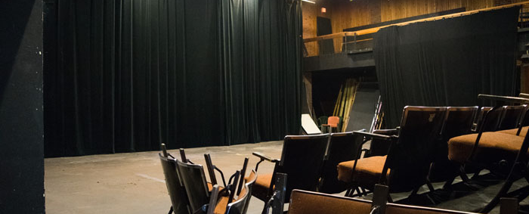
And the show begins…

Slide 4

Project deliverables:
An online database:
currently holds 75 items.
keeps track of who borrows item, contact information of borrower, what item borrowed, check-out time, check-in time, etc.
Quick Response (QR) codes for each item.

Slide 5
Database details here:
[client can login and change password]
[Describe database]
[Screenshots]

Slide 6
Talk about front end:

Slide 7
QR codes here:
[Details and picture here]
Can bring an item to class to show implementation of QR codes

